Slide 1
Project management

Slide 2
Project management overview
“Project management is the application of knowledge, skills, tools, and techniques to project activities to meet project requirements”.
Effective communication is the first benefit project management provides, which leads to smoother running projects.
Adaptability is the second benefit that project management provides by allowing projects to effectively respond to organizational, marketplace, customer, and project changes.
What project management provides
Communication
Adaptability

Slide 3
PROJECT manager ‘s role
The project manager is the only one with the most holistic view of the project, and so project managers often have to fulfill many unnamed roles, including:
The visionary
Relationship manager with the customer, stakeholders, organizational management, and the project team
Leader, mentor, and coach
Change agent
Project public relations manager
Facilitator
Marketing manager
Arbitrator
Negotiator
Business manager
Coordinator

Slide 4
PROJECT Manager responsibility
“Core responsibilities for Successful completion of project lies on both project team and project manager,
Though ultimate responsibility lies on project manager”
Identify requirements
Establish objectives
Project Manager Responsibilities
Balance constraints
Develop project plan
Maintain professional ethics

Slide 5
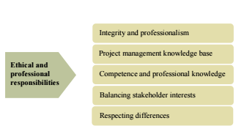
Ethics

Slide 6
Ethics
Ethical Responsibilities are:
Not compromising our integrity through real or perceived conflicts of interest
Keeping confidential information under wrap and fully abiding with confidentiality agreements
Providing honest and accurate information to stakeholders, customers, the project team and management
Not accepting inappropriate gifts or compensation for our project management work
Dealing with people in a respectful and direct manner
Reporting to PMI unethical behavior of PMI members or PMPs, as well as responding promptly and honestly to inquiries from PMI investigating unethical behavior
Honoring commitments, deadlines, and promises we’ve made
Maintaining a proper motive behind our actions and decisions; not letting our personal gain influence our actions and decisions

Slide 7
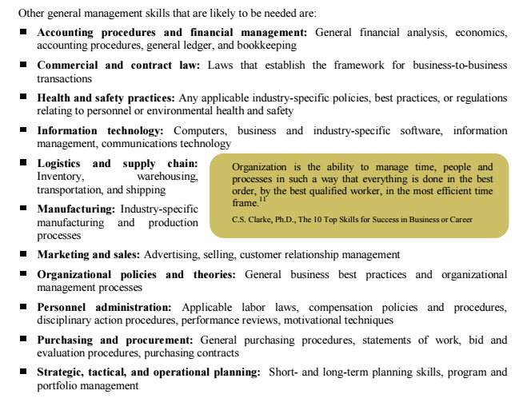
GENERAL MANAGEMENT SKILLS

Slide 8
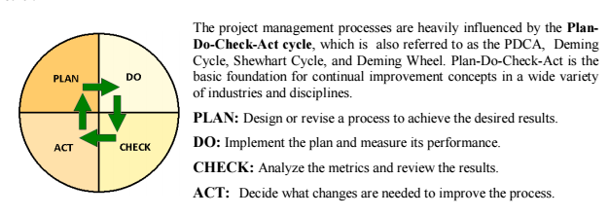
Project management processes

Slide 9
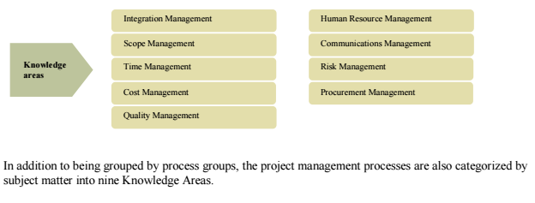
Knowledge areas

Slide 10
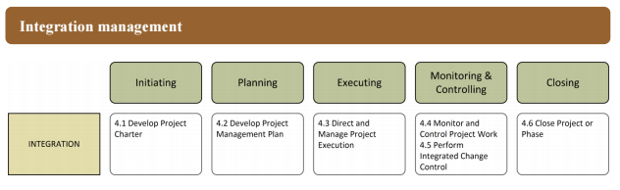
Knowledge areas
Processes in Project Integration Management “Processes and activities needed to identify, define, combine, unify and coordinate different processes and activities with project management process groups.” Integration Management is the only Knowledge Area that includes processes from each of the five Process Groups --Initiating, Planning, Executing, Monitoring and Controlling, and Closing. What holds a project together? That would be project integration management, which includes such fundamental plans as developing a project charter that is created during the initiation phase. In short, project managers will have to keep an eye on every aspect of a project and check if everything is going according to the plan.

Slide 11
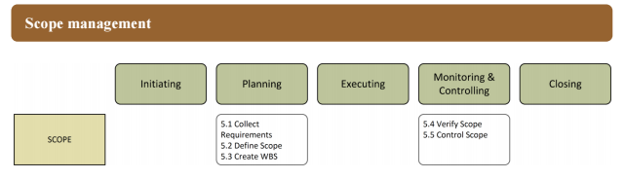
Knowledge areas
Project Scope Management This knowledge area deals with defining the project scope, project requirement scope, project work, making the work breakdown structure, making the scope baselines and managing the scope of the project. Scope creep and lack of proper scope document is one of the main reasons behind project failure. Furthermore, defining and documenting all the work comes under scope management. Your project team should know what the deliverables are and what problems your project will solve. All this makes it easier for your team members to achieve the goals and helps clients in knowing what to expect from the projects. Therefore, project scope should also contain milestones related to projects.

Slide 12
Knowledge areas
There are five sub-processes involved in the project scope management process.
Collect requirements (Document stakeholder requirements)
Define scope (Detailed description of project and what it will do)
Create work breakdown structure (Dividing projects into smaller tasks)
Verify scope (Getting acceptance of project deliverables from stakeholders)
Control scope (Difference between actual and approved scope)

Slide 13
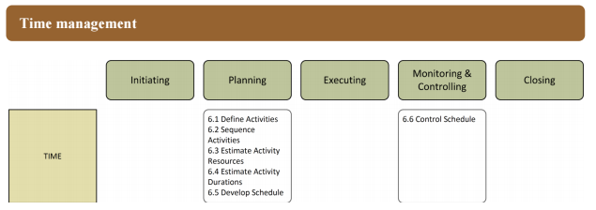
Knowledge areas
Project Time Management includes the processes necessary to construct and control the project schedule and complete the project on an agreed-upon timeline. The time management processes must occur at least once on every project and may also occur for each project phase. The project managers estimate the duration of the tasks in this knowledge area. This is where PM sequences the tasks and chooses the number of resources required to achieve the objective of the project. Schedule is monitored and managed here in this area to keep the project
on the track.

Slide 14
Knowledge areas
here are seven sub-processes associated with the project time management knowledge area that every project manager should know in order to complete projects on time.
Define activities
Sequence activities
Estimate the resources required
Estimate the time required
Develop a schedule
Control the schedule

Slide 15
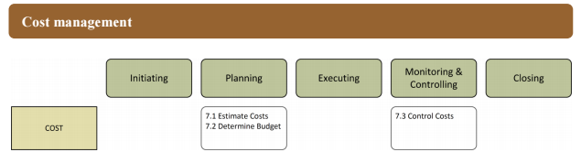
Knowledge areas
Processes in Project Cost Management are focused on planning, estimating, budgeting, and controlling
costs so that the project can be completed within its approved budget. In some projects the Cost
Estimating and Cost Budgeting processes may be approached as one process because they are so tightly
linked. The Cost Control process contains several formulas that are used for performance measurement
and forecasting.

Slide 16
Knowledge areas
Three main sub-processes involved in project cost management.
Estimate costs
Determine budget
Control costs
Make sure that you keep an eye on budget and expenditures so that you do not end up exceeding the budget. Unfortunately, most project managers do not pay attention to cost management from the beginning, spends a major chunk initially without any record and struggles to keep the project inside the budget later on. To keep project costs in check, you should track every dollar and where it is spent.

Slide 17
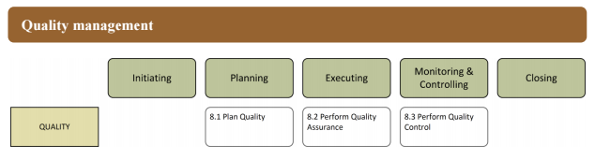
Knowledge areas
Project Quality Management is about ensuring that the deliverables meet the requirements for which the project was undertaken. Project Quality Management is compatible with both the International organization for Standardization (ISO) and proprietary quality approaches, such as Total Quality Management (TQM) and Six Sigma, and common themes in this knowledge area are customer satisfaction, prevention over inspection, and continuous improvement.

Slide 18
Knowledge areas
A high-quality project is one which satisfies the customer needs and does not contain any defects and deficiencies. In order to achieve the highest project quality, project managers and their team should focus on customer requirements they have gathered initially, try to know what the customer wants and which problems your project will solve.
Develop a prototype of the project and give it to the end user to use it. Their feedback will allow you to make necessary adjustments before you deliver the final product to the customer. At the end of it all, the project should completely align with the user requirements in order to be called a high-quality project. Hence, all the requirements should be well documented so that your team can deliver a project that satisfies customer’s requirement.

Slide 19
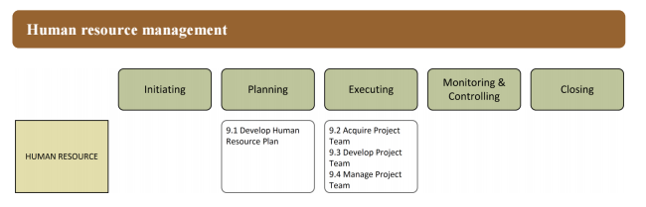
Knowledge areas
Project Human Resource Management deals with the processes and activities to organize, manage, and
build the project team. The project manager has ultimate responsibility to ensure the project is successful,
but he or she can only succeed with the active involvement of the project team in planning, decision-
making, and of course executing activities. This knowledge area, which is the HR management of the project, comprises of the processes very essential to define the ways human resources will be utilized, developed, acquired and managed.

Slide 20
Knowledge areas
Project Human Resource Management process involves following sub-processes:
Developing a human resource plan
Hire the project team
Develop a project team
Manage project team

Slide 21
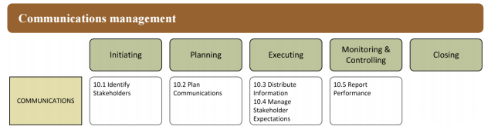
Knowledge areas
Project Communications Management provides processes for communication planning, information
distribution, performance reporting, managing stakeholders and controls information flow within the project. Each of these processes will occur at
least once for the project and may also occur for project phases.

Slide 22
Knowledge areas
Here are some of the key activities that project managers need to undertake to ensure uninterrupted communications throughout the project:
Identify stakeholders
Plan communications
Distribute information
Manage stakeholder expectations
Report performance

Slide 23
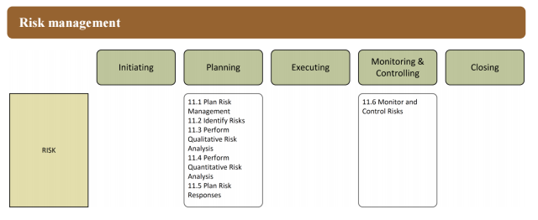
Knowledge areas
Risks are uncertain events that impact one or more of the project objectives. The objectives of risk
management processes are to decrease the probability and impact of negative events and increase the
probability and impact of positive risk events. Project Risk Management ensures that risks are identified, analyzed, plans established, and managed.

Slide 24
Knowledge areas
project managers can reduce the risk by following a proactive approach and managing risks at the initial stage. Project managers who ignore minor risks have to suffer from project failure because these minor risks can turn into major risk and can lead to a project disaster if left unattended. Here are some of the activities that project managers will have to undertake in project risk management:
Plan risk management
Identify risks
Perform qualitative and quantitative risk analysis
Plan risk response
Monitor and control risks

Slide 25
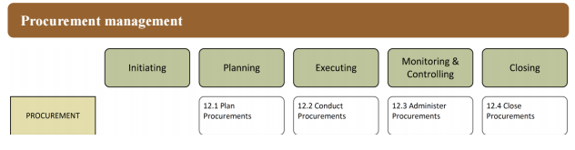
Knowledge areas
Many projects require outside products, services, or other resources outside of the project team. Project
Procurement Management includes make-or-buy analysis, purchasing, vendor selection, contract
administration, and contract management activities.

Slide 26
Knowledge areas
The Project Procurement Management knowledge area covers all the aspects related to purchase and acquiring of products and services needed to complete projects effectively. Although, the procurement process is quite transparent and conducted through a contract or agreement, it important for project managers to ensure that there are no discrepancies. Whether you are a buyer or seller, you need to understand both perspectives to get a better knowledge of the project procurement process. Additionally, cost benefit analysis, cost utility analysis, and risk analysis also comes under project procurement management.
Plan procurement
Conduct procurement
Administer procurement
Close procurement

Slide 27
Knowledge areas
Project Stakeholder Management area encompasses all the processes which is used by a project manager for recognizing and satisfying the ones who are affected by the project. The affected party can either be internal or external, in nature. You can pay close attention to those stakeholders who can have a powerful positive or negative impact on the project. There are four processes in stakeholder management.
identify the stakeholders
plan stakeholder management
managing stakeholders’ expectations
control stakeholder engagement

Slide 28
Jazak Allah Khair

